Slide 1
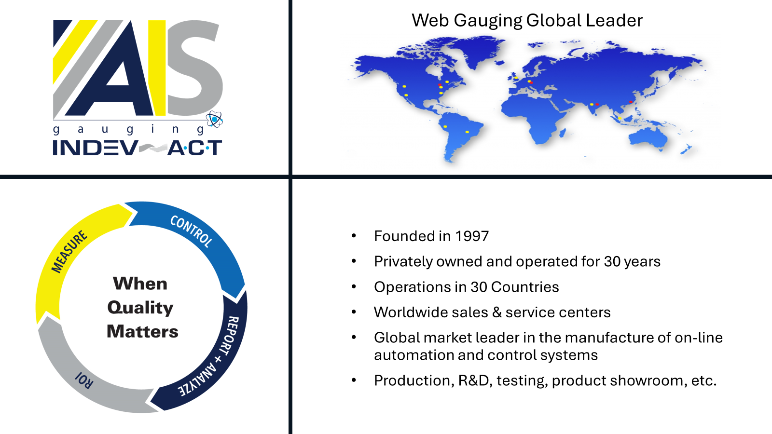

Slide 2
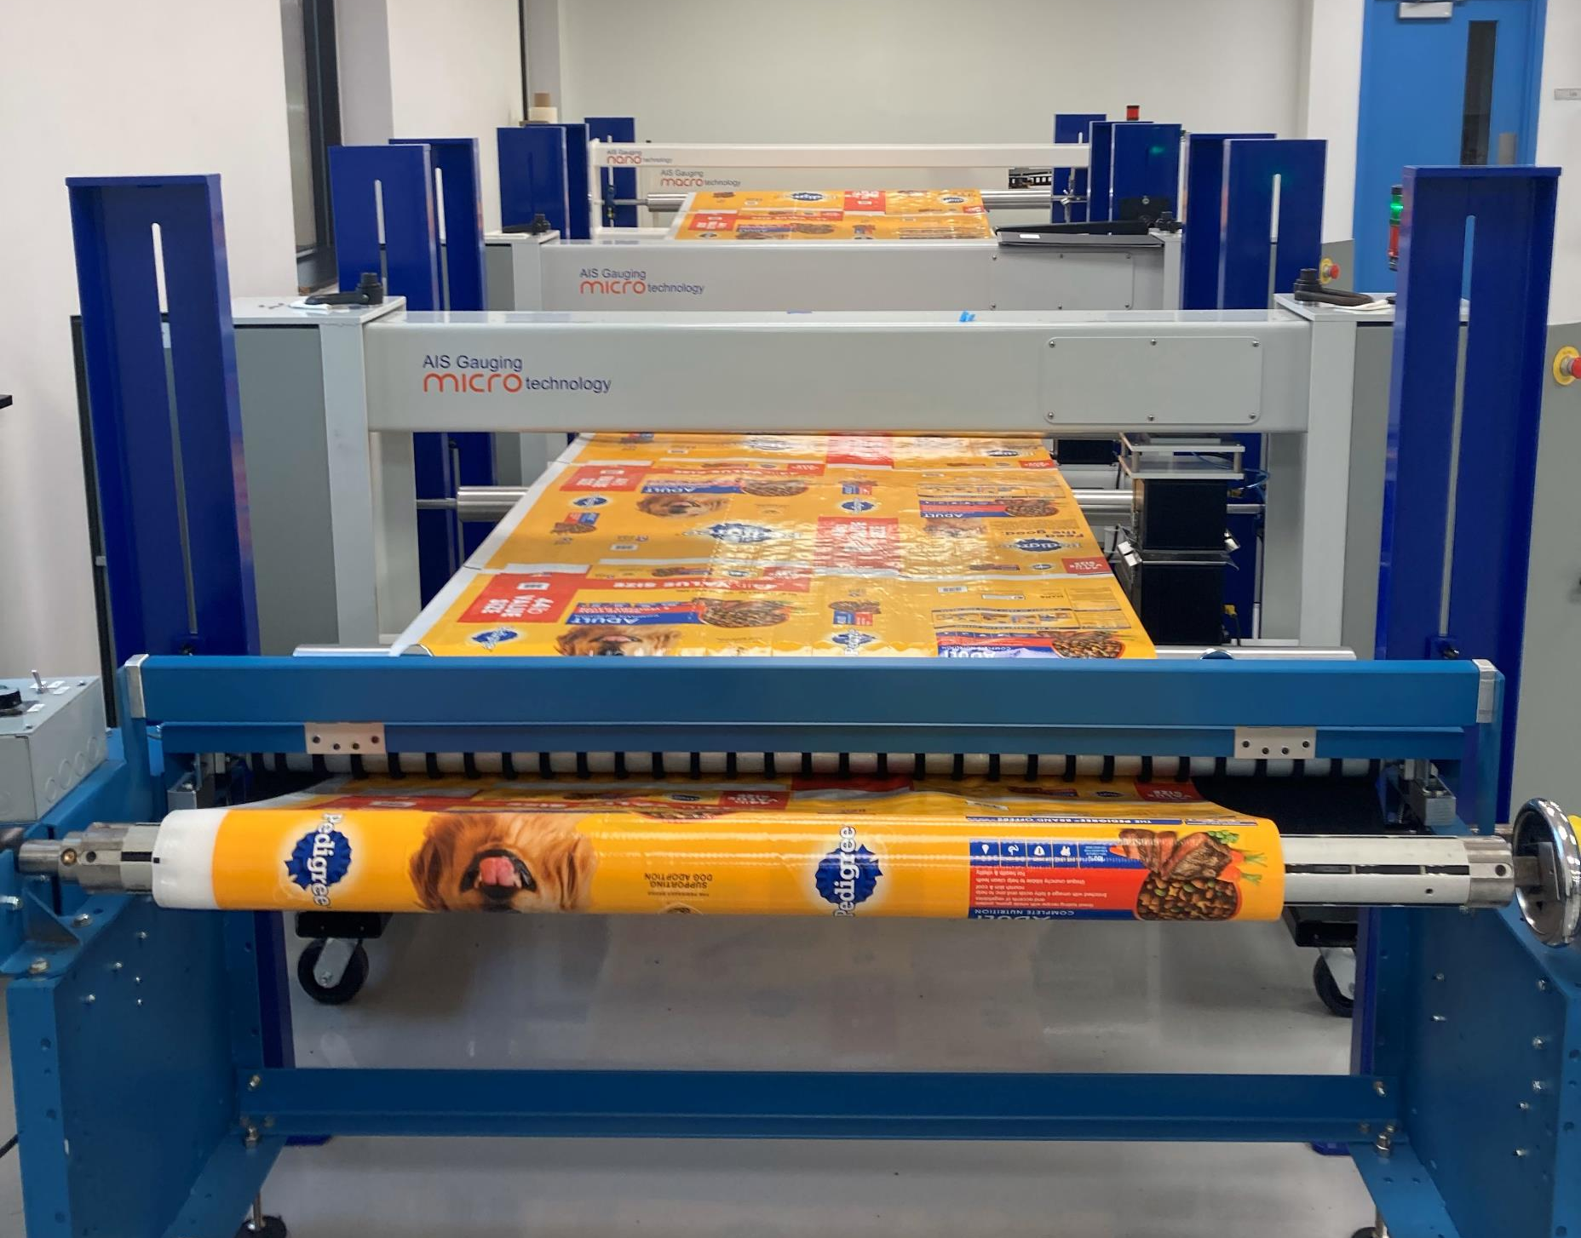

AIS Pilot Facility
Terre Haute, IN

Slide 3
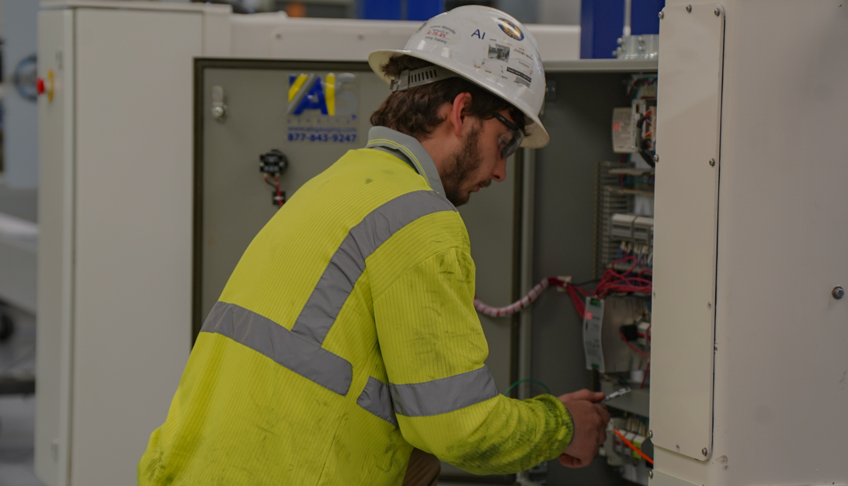
AIS GAUGING
Service and Support
Remote Access
24/7 Support
8 Service Engineers in North America
All Parts Stocked and Available to Ship Overnight
Emergency Onsite Support

Slide 4
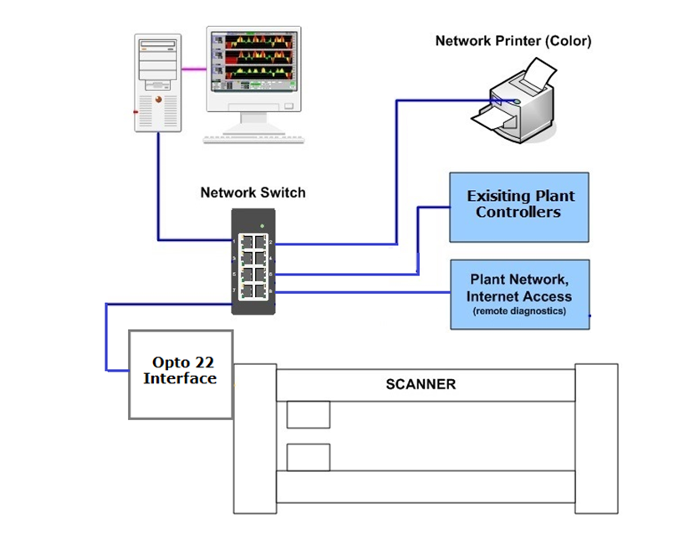
AIS Gauging Upgrades
Minimal Downtime
Non-proprietary off-the-shelf components
No Forced Obsolescence
  IO Processor and Module Supported for Life
Open Platform Architecture
  OPC tag-name Driven
  Seamlessly Integrate into any Existing PLC or Data Collection System

Slide 5
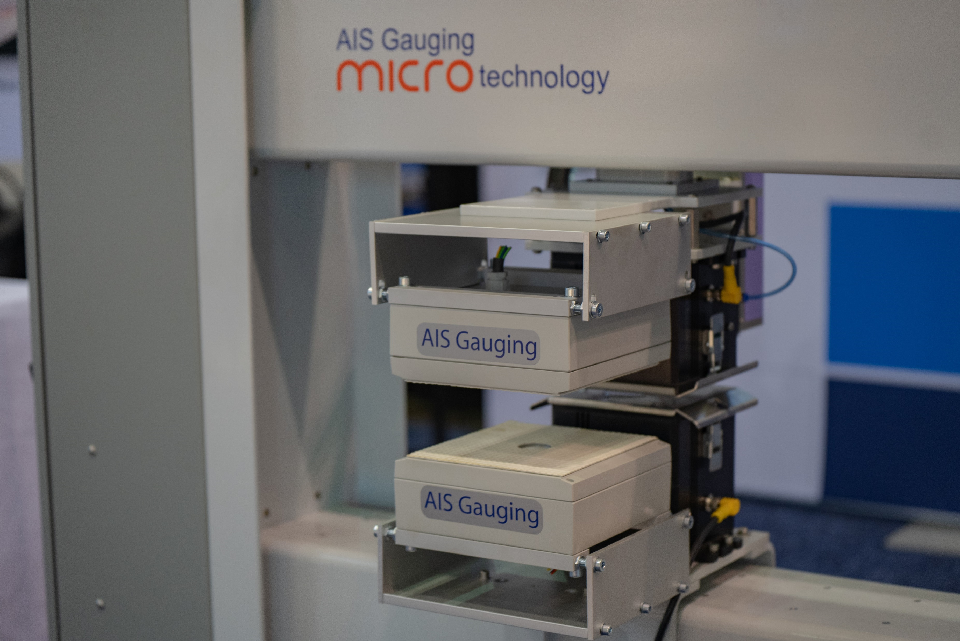
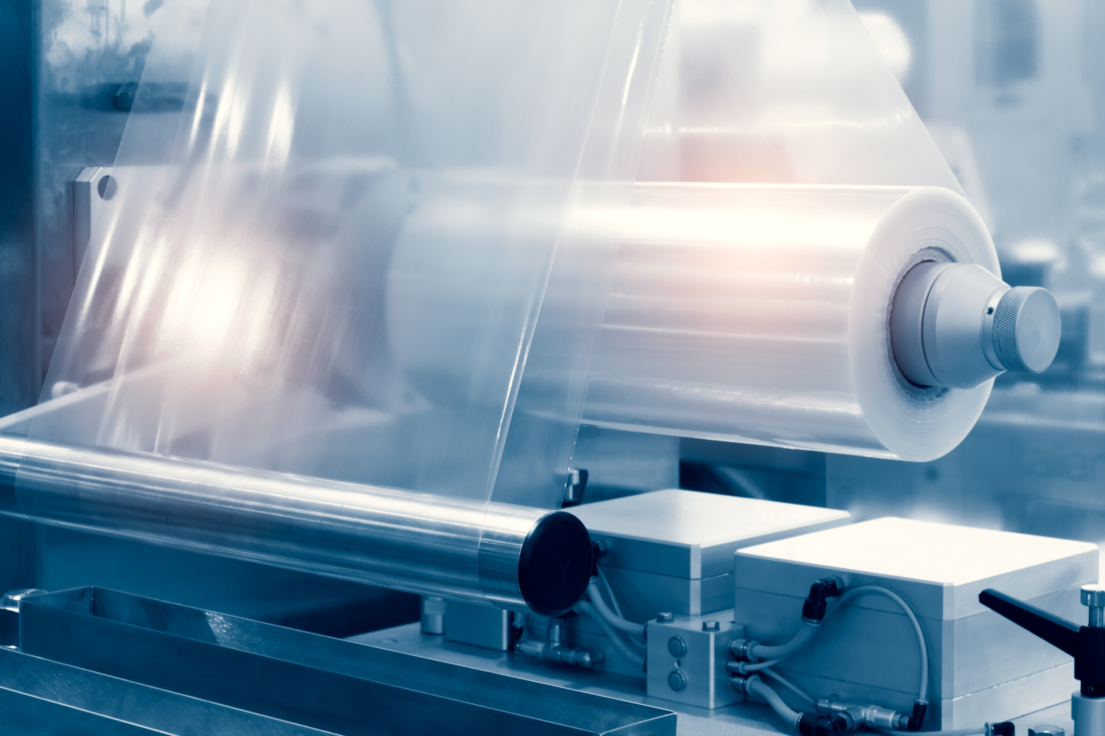

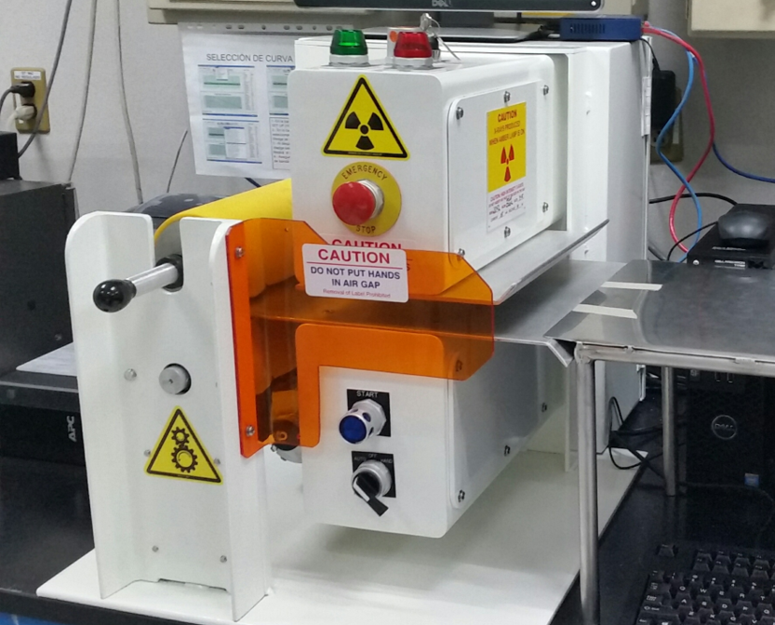
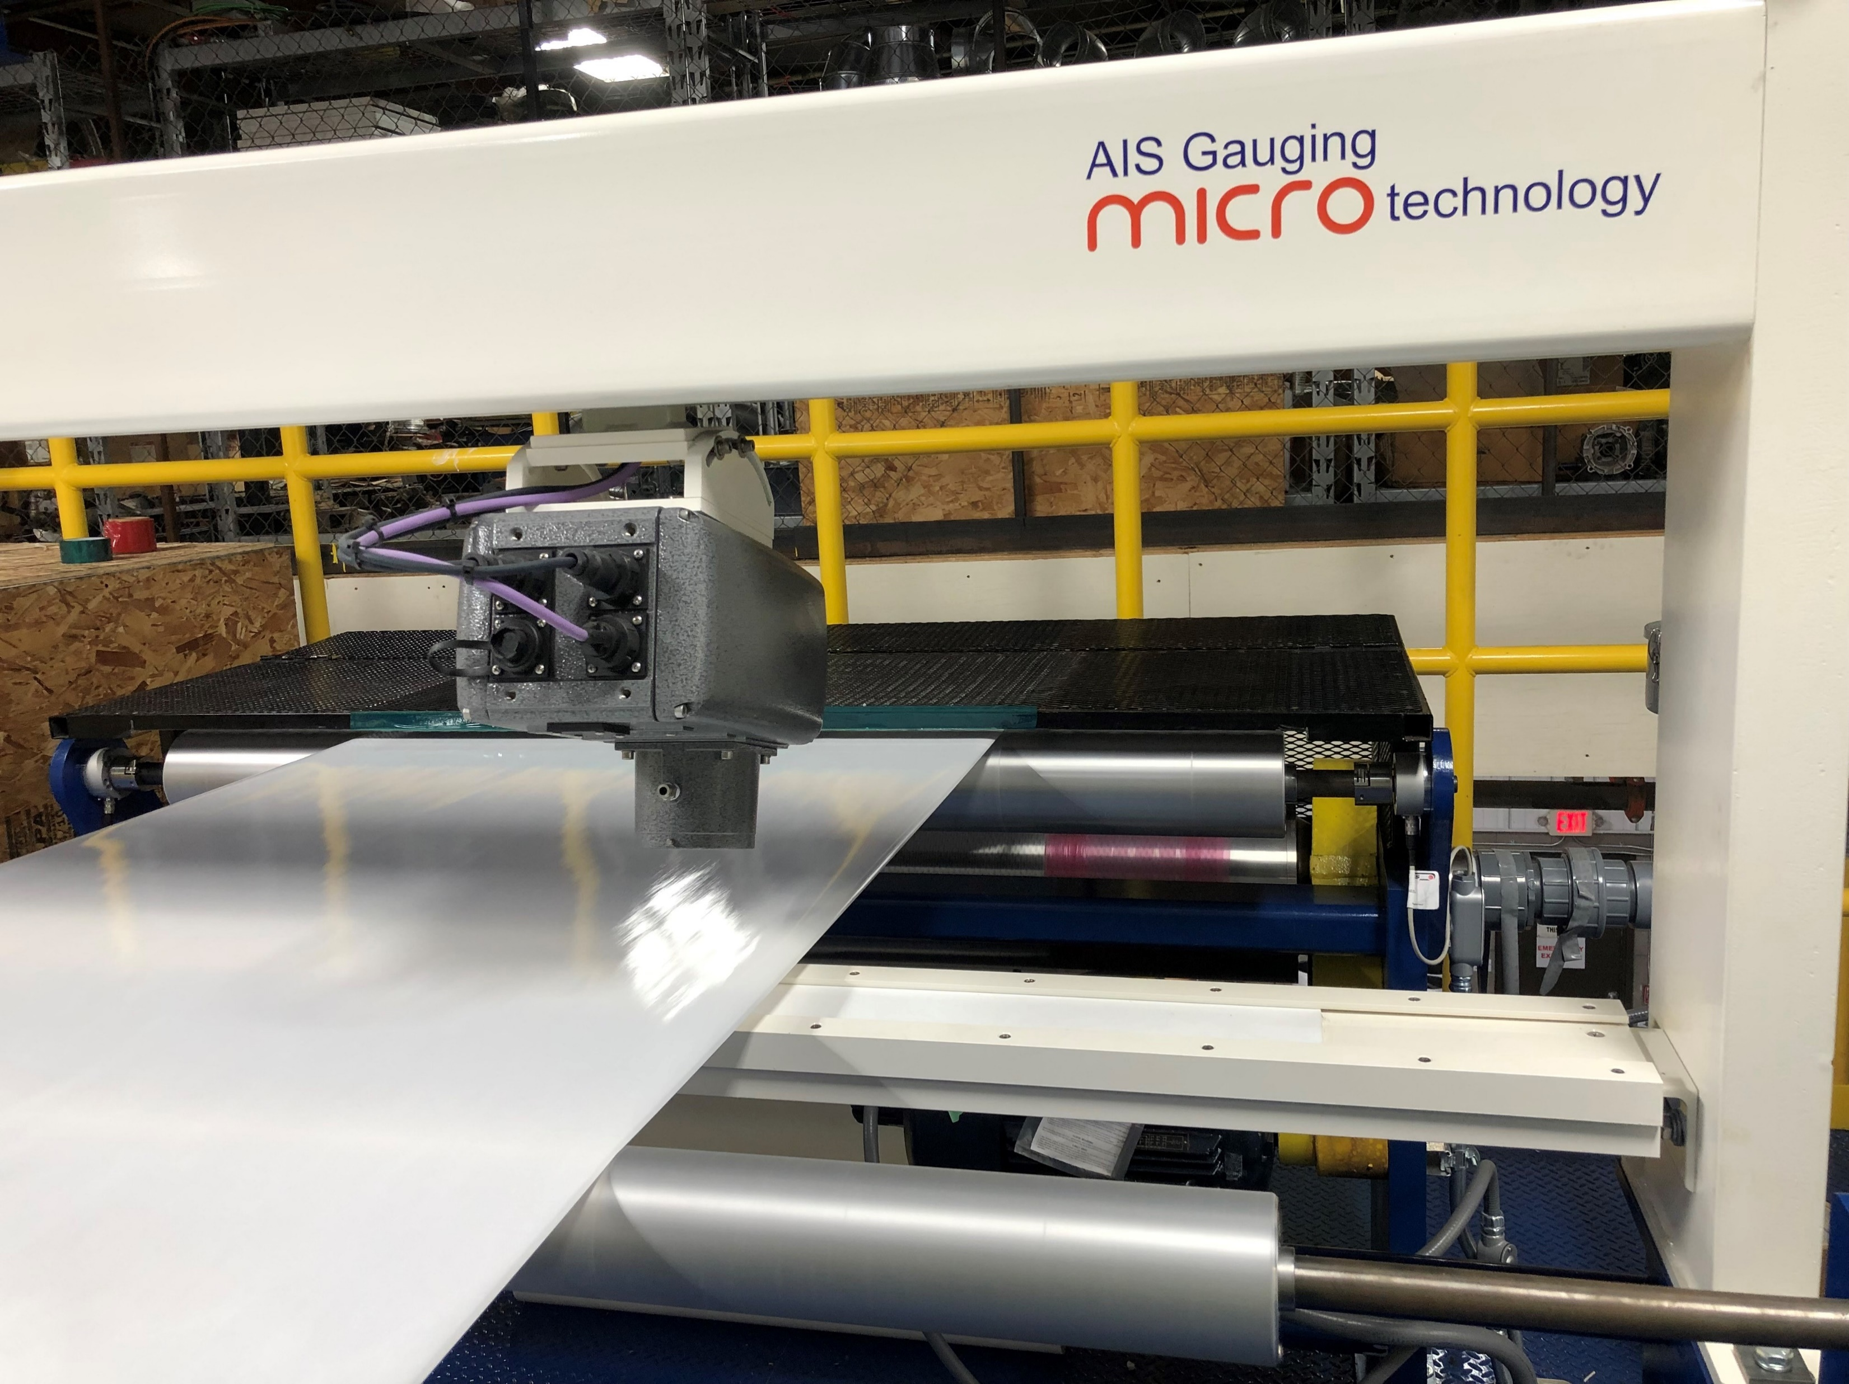
AIS GAUGING INSTALLS
We have emerged as a leading provider of Online Non-contact Gauging & Control Systems globally for production lines in the fields of
  Plastics Extrusion : Extruded Sheet film, Cast film, Blown film , Bi-axially oriented film
  Non-Woven & textiles : Spun-bonded fabric , Spun-lace fabric
  Extrusion Coating : Wet & Dry Liquid solution coating
  Lamination & Converting
  PVC Calendaring film
  Rubber Calendaring
  Pre-preg Composites
  Metal Application: Steel & Other Metal Mills, Hot Melt Coating, Cold mills, Process lines, Reversing mills, aluminum foil
  Paper Mills
  Battery Energy Application: Anode coating, Cathode Coating
  Foam Material
  Textiles / Carpet /Roofing material /Flooring material
  Float glass
  Fiberglass insulation film

Slide 6
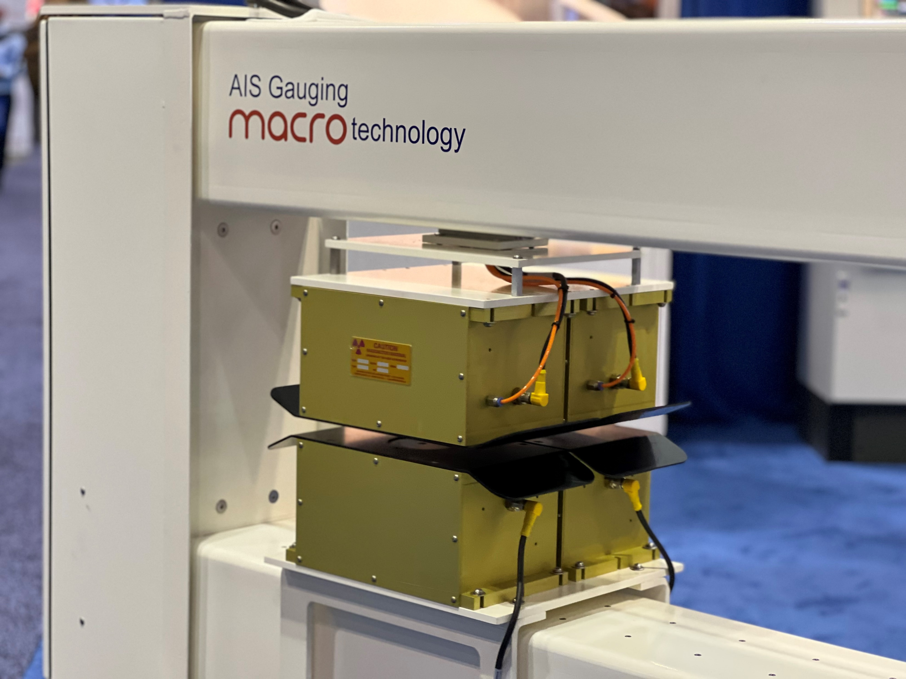
AIS Gauging Measurement Sensors
BASIS WEIGHT SENSORS
  BetaTEK (Sr-90, Kr-85)
  X-Ray Backscatter Sensor
  X-Ray Transmission Sensor
  Infrared Absorption
  Ultrosonic
MOISTURE SENSORS
  InfraTEK
  WaveTEK
CALIPER THICKNESS SENSORS
  LaserTEK - Laser Triangulation (Single- and Dual-Sided)
  ShadowTEK
  TeraHertz
AIR PERMEABILITY SENSOR
  PirosityPRO

Slide 7

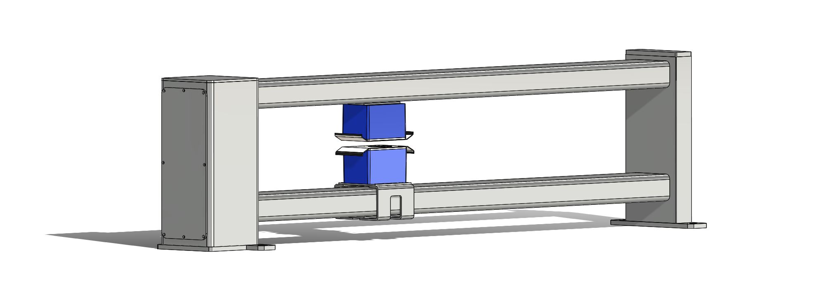
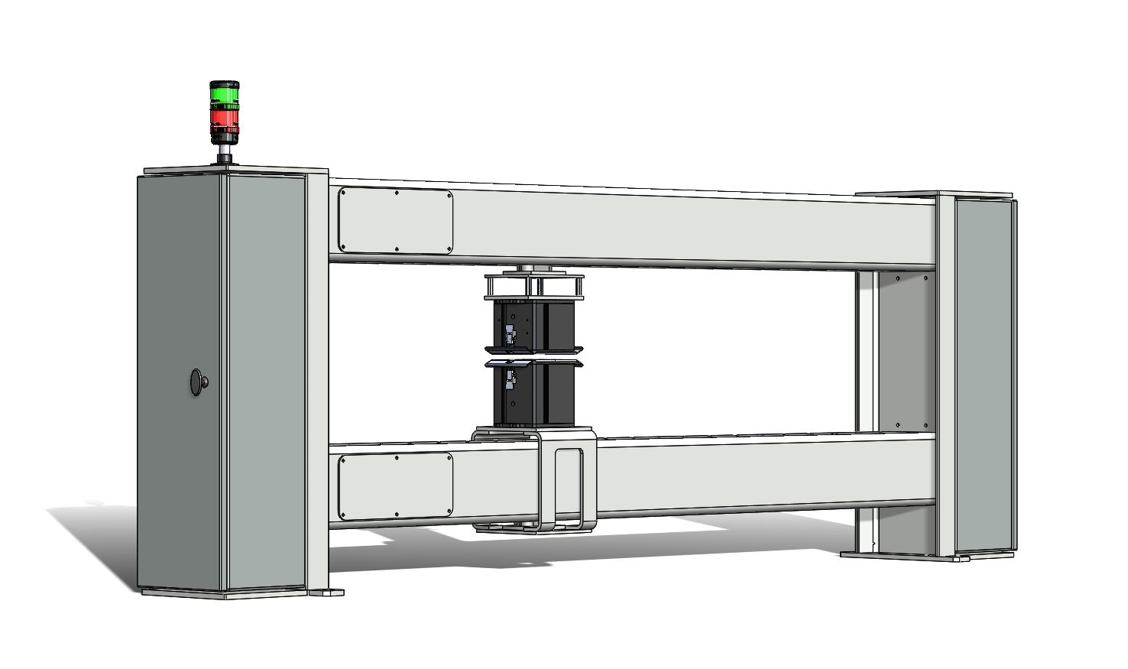
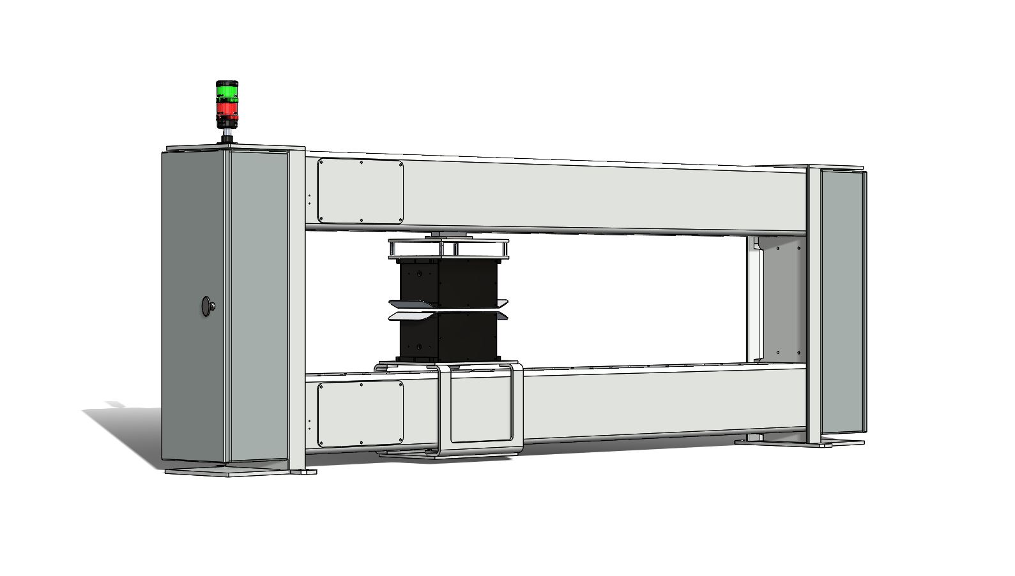
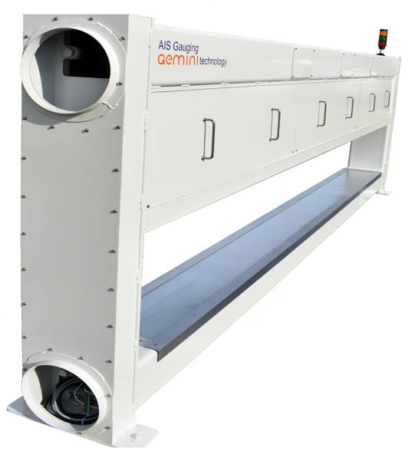
Web Measurement & Control Systems
AIS offers a wide array of frames :
Industrial O-frames
Industrial C-frames
Industrial I-frames
In Models :
Macro Frames ✓ Micro Frames
Nano Frames ✓ Monobeams Frame
Rigid C-Frames
Gemini Frame with defects detecting :
:This is a new patent pending technology that can give full width measurement with no moving parts while also detecting material defects.

Slide 8
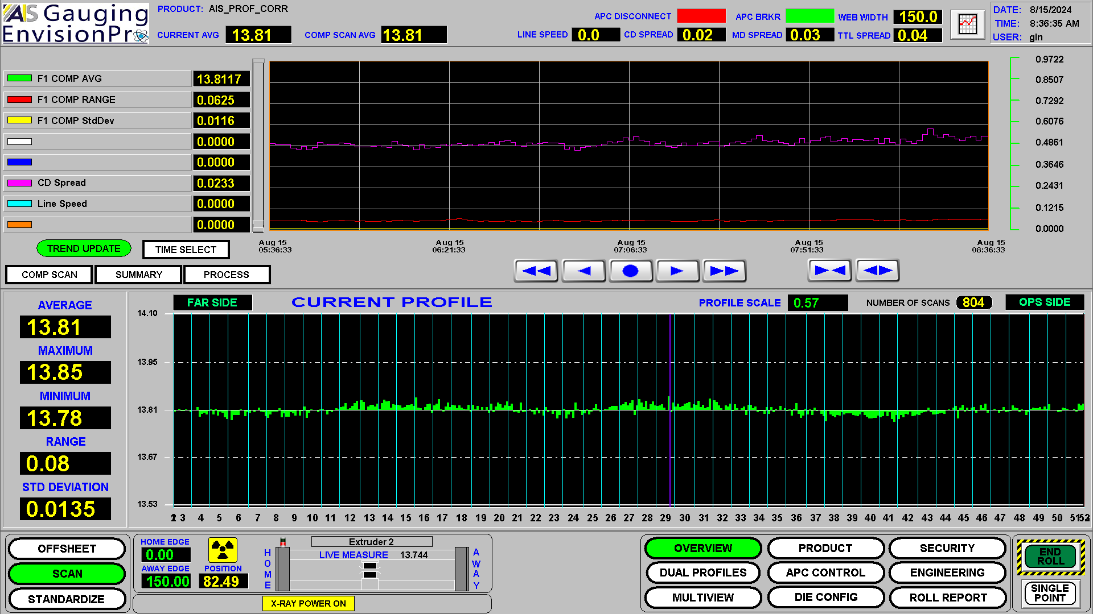
EnvisionPro HMI
Overview Display
The upper portion of the display provides an 8-pen historical trend to view any variable within the HMI.
The lower portion of the display contains a set of different displays, typically set to the measurement profiles.

Slide 9
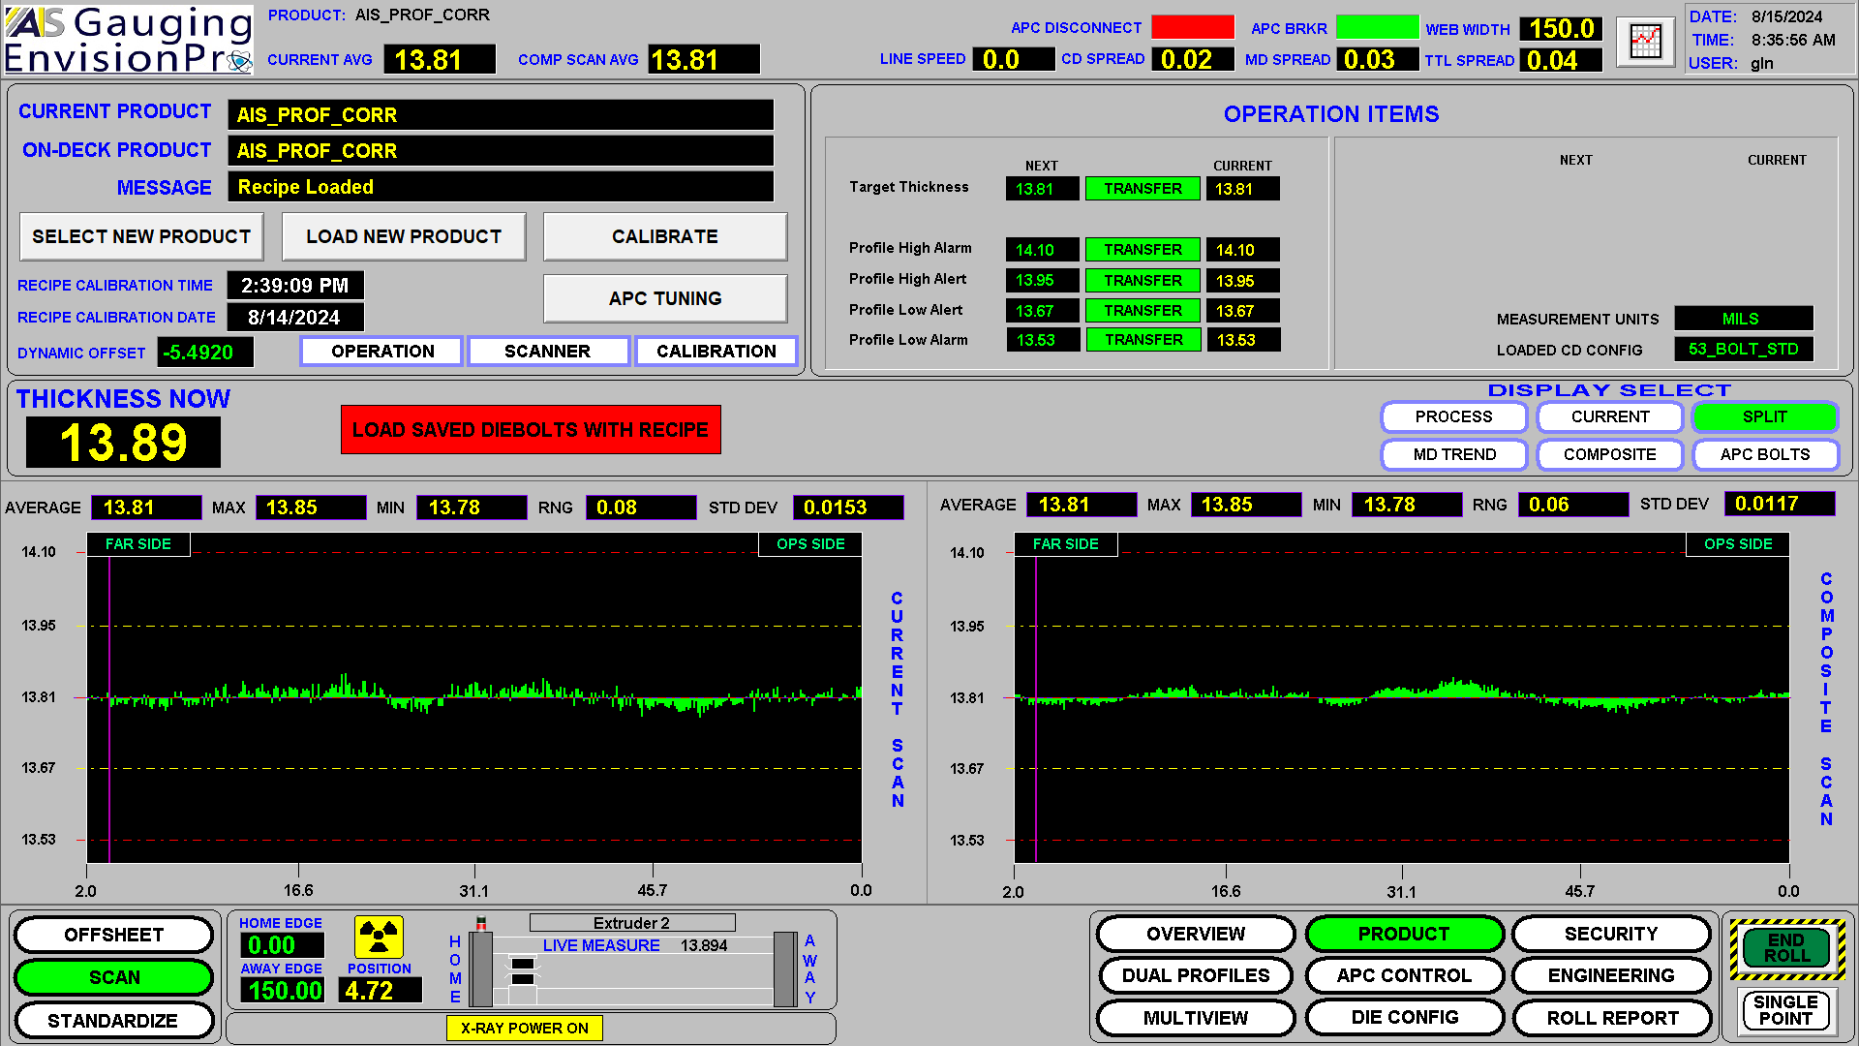
EnvisionPro HMI
Recipe Load
Recipe select & load buttons. Selecting a recipe allows you to place a product on-deck from the database. Loading the recipe puts the on-deck product active.
Displays the difference between on-deck & active recipe items. You may modify on-deck items here (temporary).
2
1

Slide 10
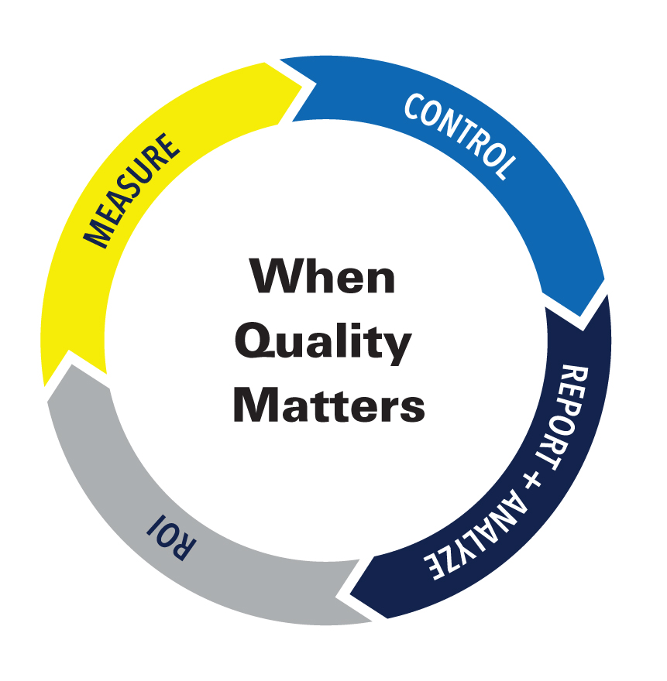
AIS GAUGING
THANK YOU FOR YOUR ATTENTION!

